Slide 1

Data Analytics: Project #01
Amal Qasiri

Slide 2




Objective
Defining the best neighborhood to invest in, in Washington. DC, using Airbnb data

Slide 3
The Case
How much revenue do successful hosts generate?

Slide 4
Data Cleaning Summary
Keeping a copy from the raw data
Freezing the first row and column
Checking the duplication
Calculating the total revenue
Defining the number of bookings
Calculating the daily revenue

Slide 5
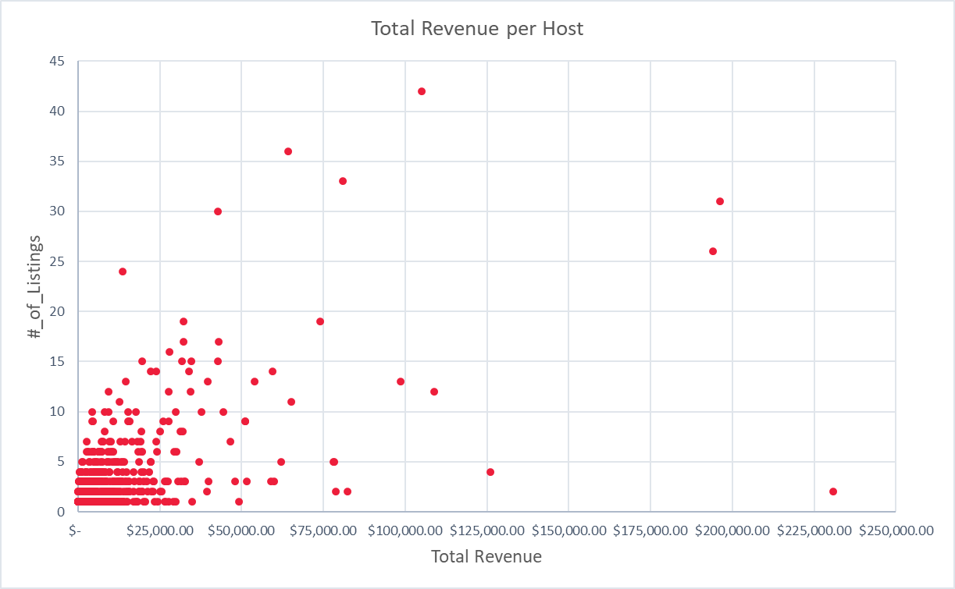
The Revenue per Host
Notes:
We can see from the chart the majority of the data shows that the revenue increases with the increasing of the number of listings, however, there are outliers in this dataset who has less listings with high number of bookings

Slide 6
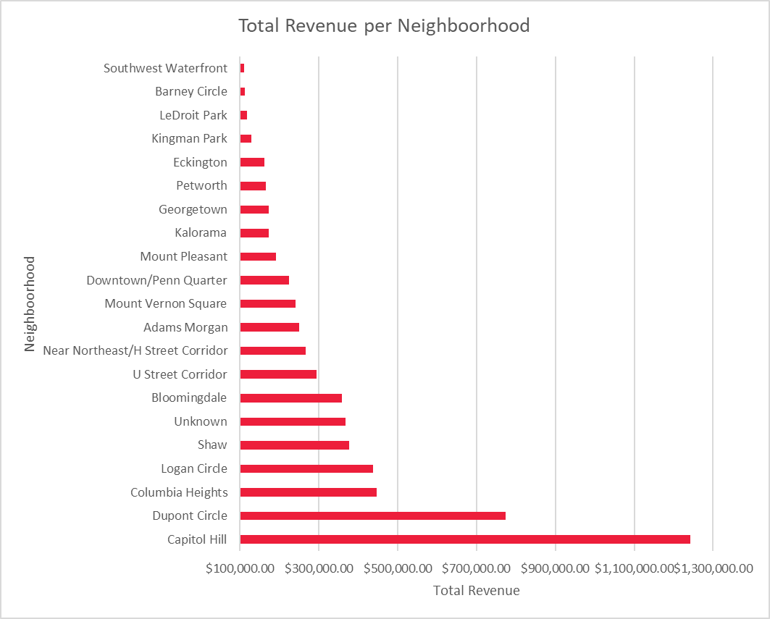
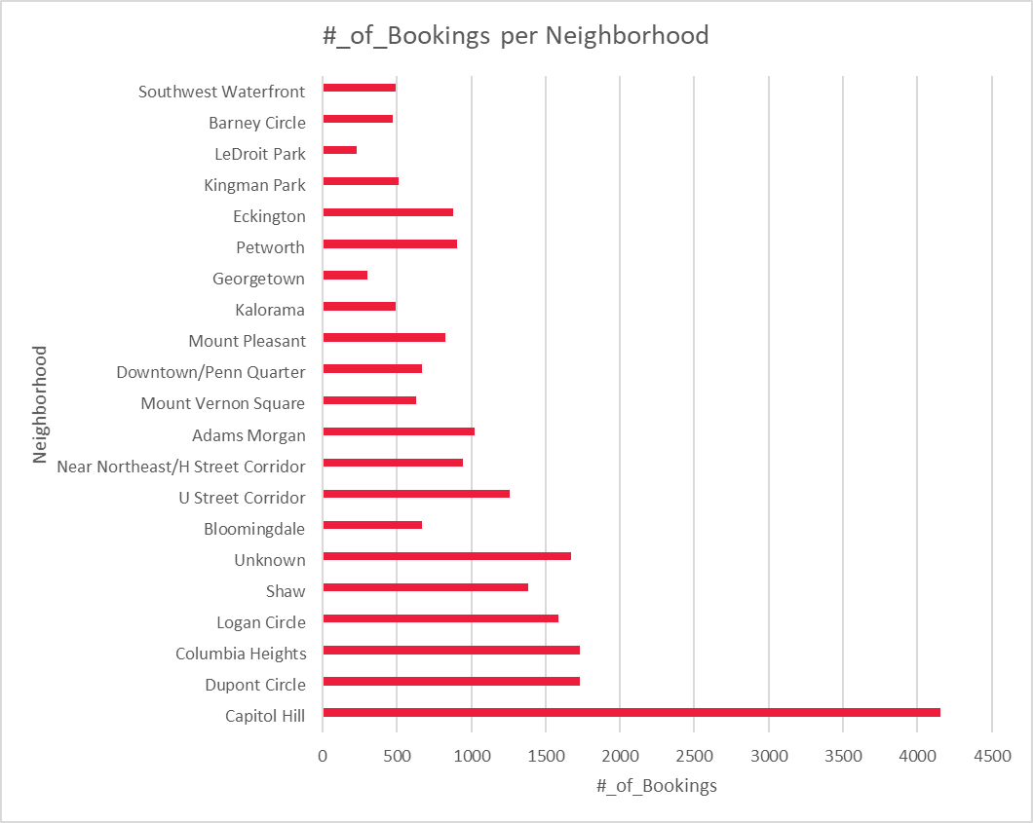
The Highest Revenue Neighborhood

Slide 7
Recommendations
As per the previous analysis shows the most recommended neighborhoods with the highest bookings and revenue to invest in are:
The top performing hosts and listings:
Hermosa $230,759 across 4 listings
Charlotte $196,134 across 899 listings
Cliff $194,026.5 across 780 listings
Gohar $126,157.50 across 16 listings
Capitol Hill
&
Dupont Circle

Slide 8
Thank You

